Slide 1
SENTIMENT ANALYSIS OF SOCIAL MEDIA PRESENCE

Slide 2
CONTENTS
  Introduction
  Objective
  Usecases
  Project Scope
  Methodology
  Snapshots
  Flow chart
  Conclusion

Slide 3
INTRODUCTION
Welcome to our presentation on the Sentiment Analysis of Social Media Presence project. With the vast amounts of data generated every day through conversations, it's increasingly valuable to extract meaningful insights from our interactions. This project introduces an innovative tool designed to analyze Social Media chats, offering users an opportunity to understand their communication patterns, frequency of topics, and the sentiment behind messages. The technology behind this tool encompasses data parsing, natural language processing, and statistical analysis – paving the way for both individual and corporate users to delve into data-driven decision-making.
Throughout this presentation, we will explore the objectives behind creating such a tool, various use cases that highlight its versatility, the overall scope of the project, and the methodologies employed for data collection and analysis. We will also share the significant results and insights that have emerged from initial testing, culminating in our conclusions about the tool's future direction and potential impact on the market.
Notes:
1

Slide 4
OBJECTIVES
The objectives of the Sentiment Analysis of Social Media Presence project extend beyond simple curiosity into the realms of practicality and necessity in an increasingly data-centric world. Firstly, the tool aims to provide an intuitive understanding of personal and group communication trends, enabling users to streamline their social interactions and foster better relationships. Additionally, it seeks to offer deep analytical insight for businesses to optimize customer engagement and support services.
Other key objectives include:
1
Engagement Enhancement
2
Emotional Intelligence
Boost user interaction by identifying peak activity times and popular subjects within chat histories.
Understand the underlying sentiment and emotional tone of conversations for improved empathy and responsiveness.
3
Data Privacy
4
Usability
Ensure user data is handled with the utmost confidentiality and security throughout the analysis process.
Create a user-friendly platform that allows for easy navigation and interpretation of analytical results.
Notes:
2

Slide 5
USECASES
The application of the Sentiment Analysis of Social Media Presence is far-reaching, with several use cases demonstrating its flexibility and utility. For individuals, it can be a tool for personal growth and understanding, providing insights into one’s communication habits. It's equally valuable for businesses aiming to understand customer engagement or manage team communications more effectively.
Some compelling use cases include:
1
Personal Insight
Users can track their most discussed topics, analyze sentiment over time, and reflect on their communication style changes.
2
Market Research
Companies can gather data on customer feedback and discussions around their products for informed marketing strategies.
3
Productivity Analysis
Teams can evaluate chat logs to identify inefficiencies in workflows and opportunities for improvement.

Slide 6
PROJECT SCOPE
The project scope for the Sentiment Analysis of Social Media Presence is defined to bracket the technological development, user experience design, and deployment strategies. It emphasizes the robust analysis of chat data while maintaining a streamlined and secure experience for users.
Key aspects included in the project scope are:
Development
Design
Deployment
Coding of algorithms for text parsing, sentiment analysis, and visualization, using state-of-the-art machine learning techniques.
Creation of an intuitive UI/UX, making the insights accessible to users with differing levels of technical expertise.
Implementing the tool in a scalable cloud-based infrastructure to handle large datasets efficiently and securely.
Notes:
4

Slide 7
METHODOLOGY
Software Requirement :-
  PyCharm
  Streamlit
  Python 3.7 or Higher
  Pyhon Libraries
Hardware Requirement:-
  Processor:800MHz
  Memory :1GB or higher
  RAM:1GB OR Higher

Slide 8
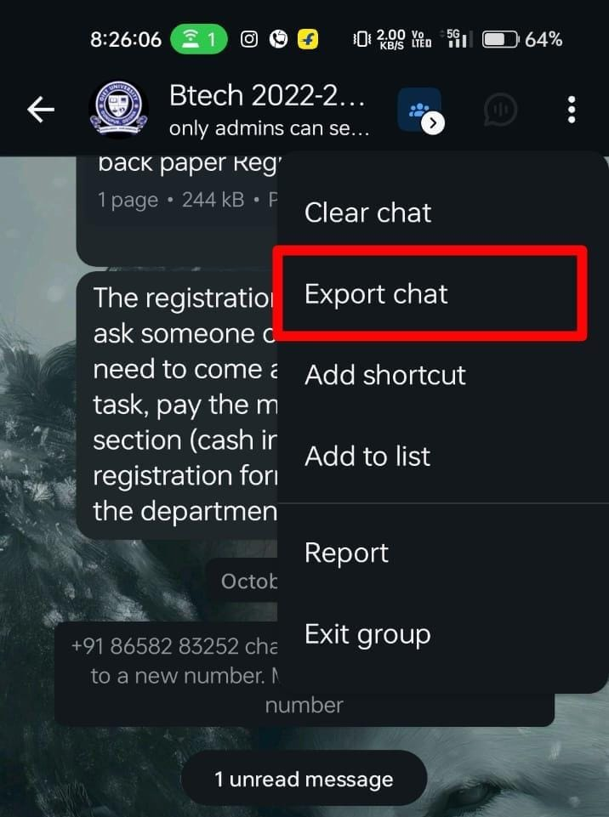
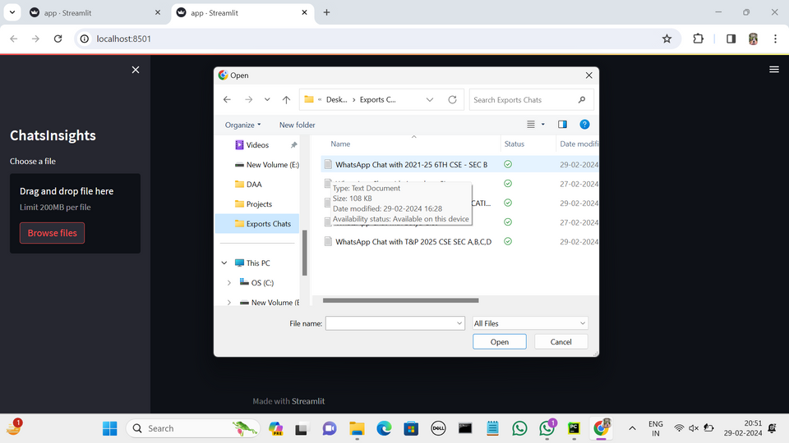
SNAPSHOTS
Export Chat from Whatsapp
Browse the exported chat to the application

Slide 9
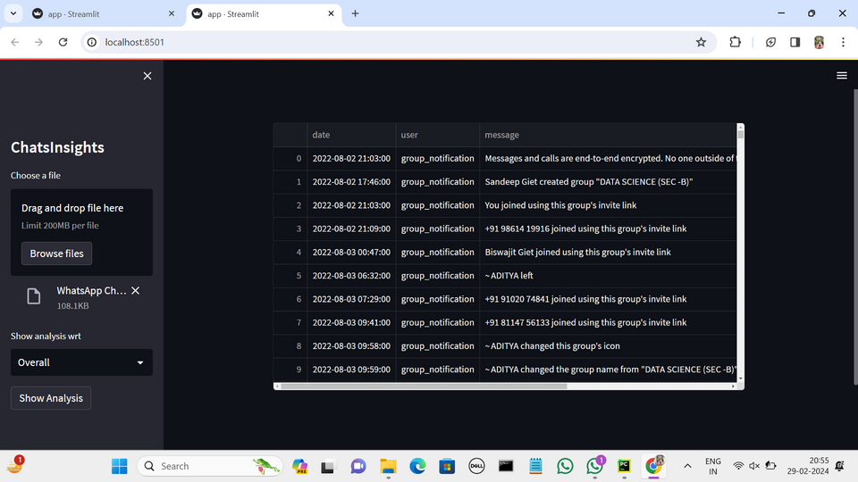
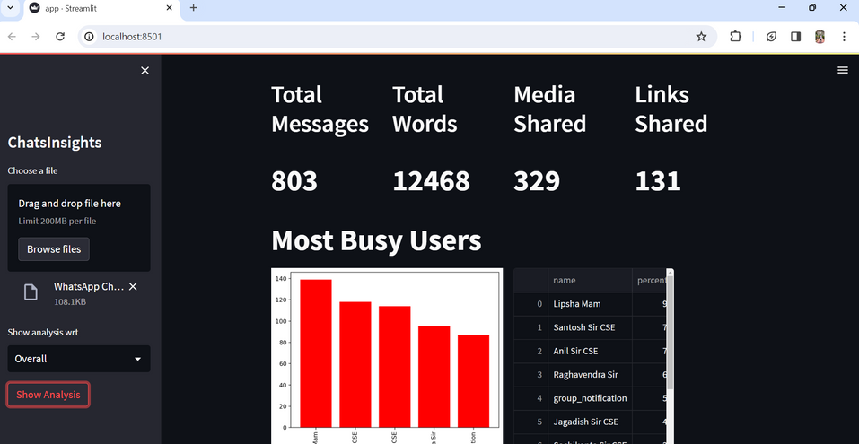
SNAPSHOTS
After Exporting it will show the date , user and message
It will show all the chat details and graphs.

Slide 10
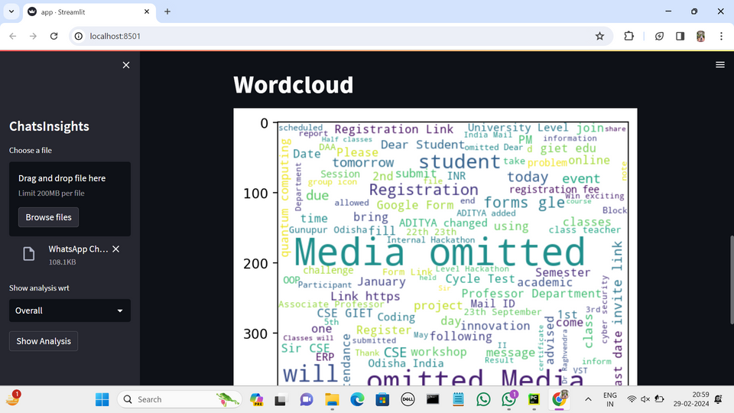
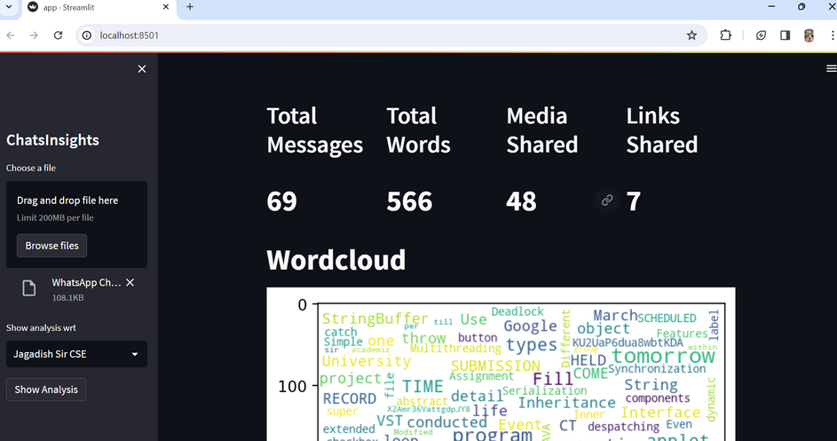
SNAPSHOTS
Word Cloud
Show perticular Group members chat details

Slide 11
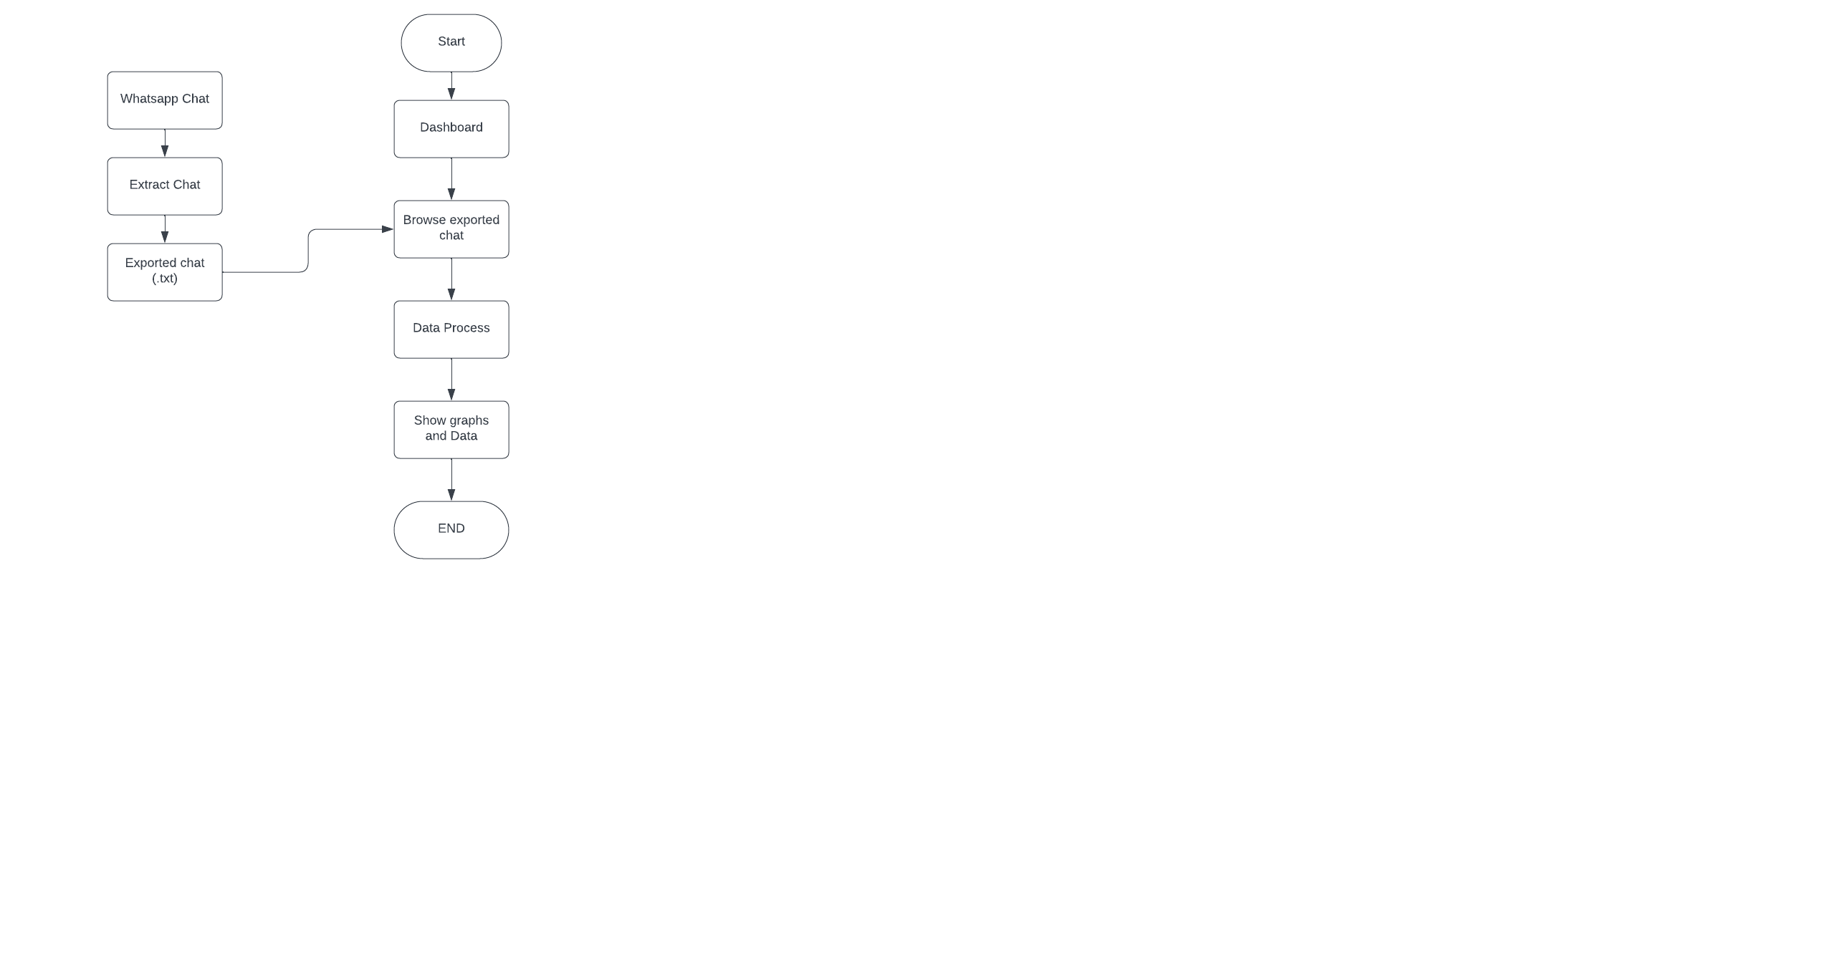
FLOWCHART

Slide 12
CONCLUSION
The journey through the Sentiment Analysis of Social Media Presence project confirms the transformative power of data analysis in understanding human communication. The project underscores the potential of chat analytics in enhancing personal productivity, improving user engagement, and fostering better relationships between customers and brands.
As we look to the future, we anticipate further advancements in the sophistication of our analytics, more seamless user experiences, and greater impacts on both personal and professional spheres. The Whatsapp Chat Analyzer stands as a testimony to the continued evolution of data-driven technology and its growing significance in our everyday lives.
Notes:
8

